Slide 1

Exam Hub
An Online Exam Portal

Slide 2



Exam Hub

Slide 3


Types of user
STUDENT
EXAMINER

Slide 4
What student can do ?
Types of user
STUDENT
EXAMINER
Register
See Result
Log IN
Log Out
Give Exam

Slide 5
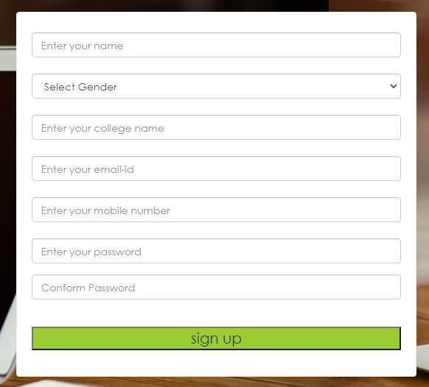
Registration
User can register by providing:
XYZ
Name
Gender
College name
Email id
Contact no.
Password (5 to 15 Charector)
male
Jagaran College
abc@gmail.com
0123456789
**********
**********

Slide 6
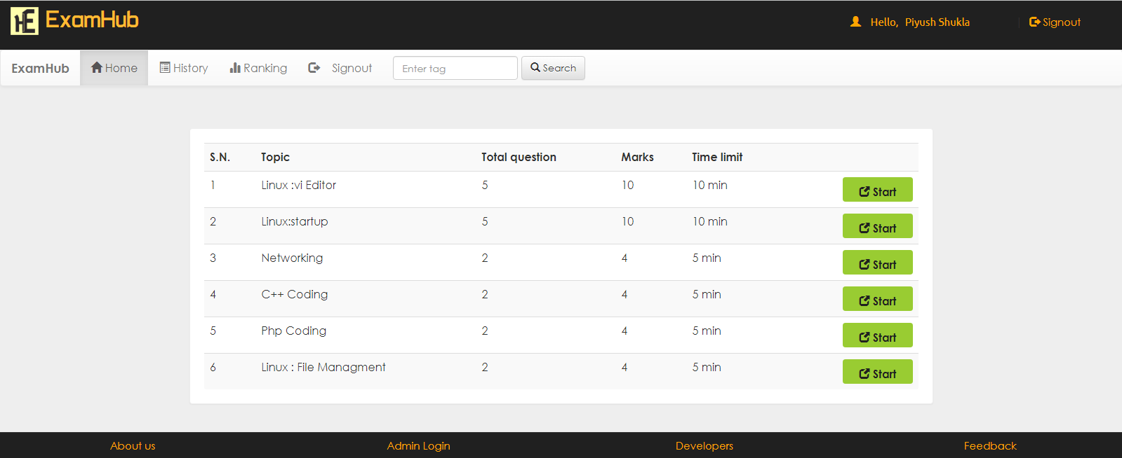
User will be redirected to their dashboard.

Slide 7
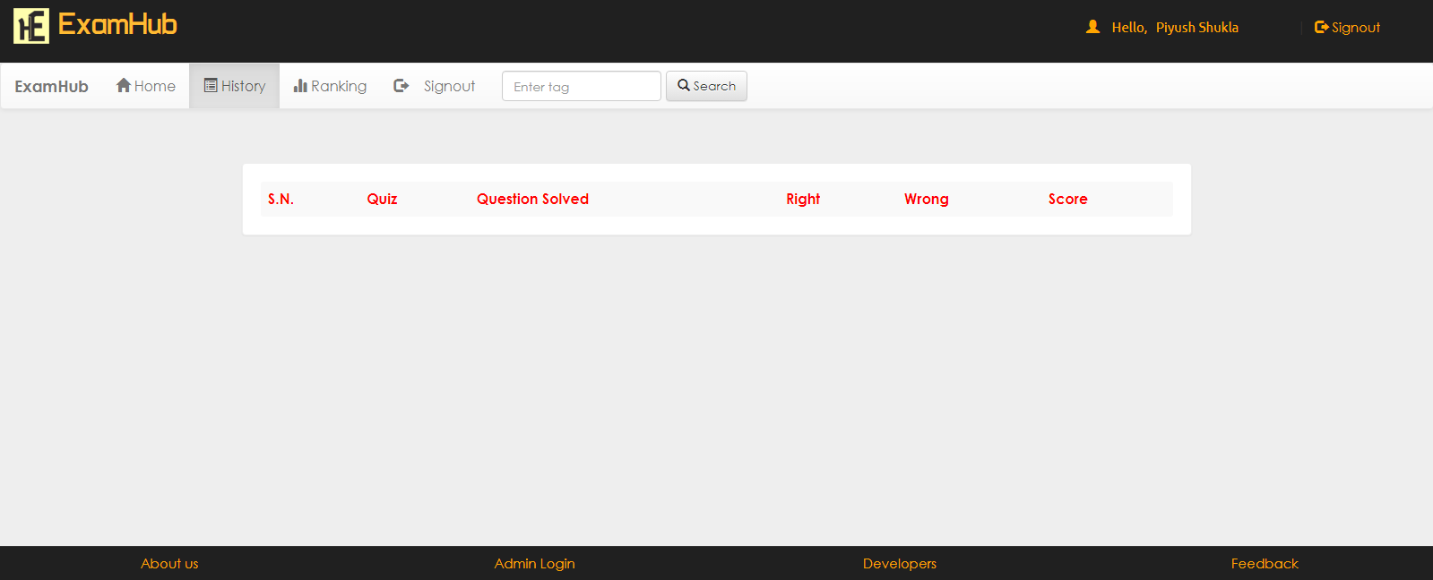
User will be redirected to their dashboard.
In history tab user can check information related to their exam.

Slide 8
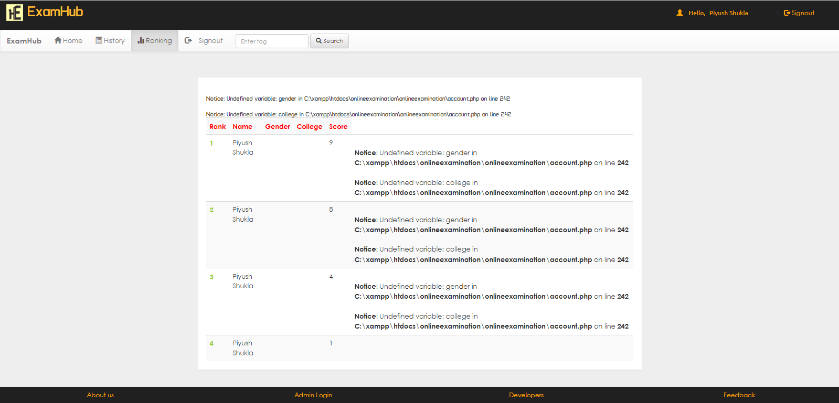
User will be redirected to their dashboard.
In history tab user can check information related to their exam.
In ranking tab user can check their rank.
Sign Out

Slide 9
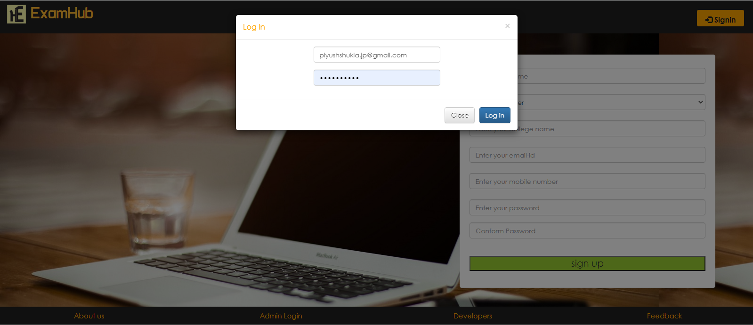
If student, is already registered, can log in by their email id and password.
Email which is used while signing up.
After logging in, student can see their dashboard.

Slide 10
Teacher Log in:
Click admin log in.
A pop up will appear.
Enter log in ID.
Enter password

Slide 11
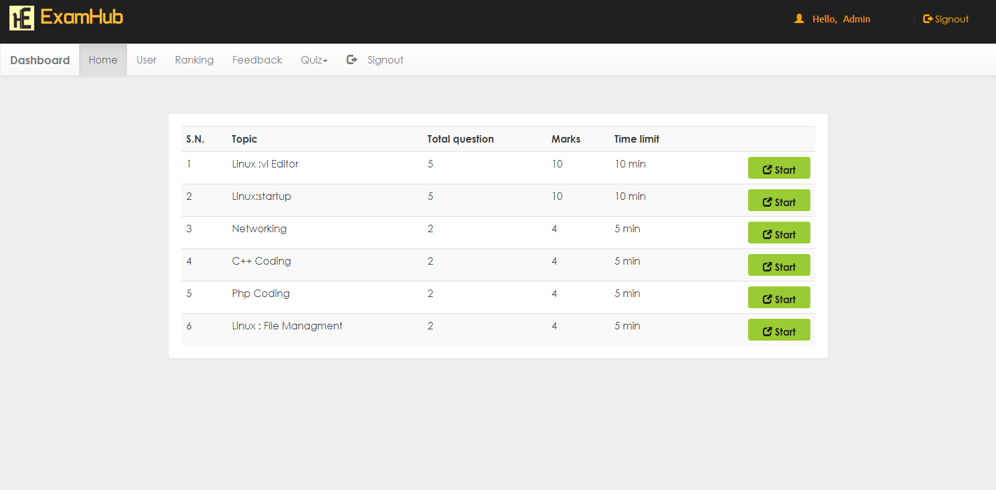
Dashboard for admin:
Admin can see users.
Ranking or performance of user.
Feedbacks from user.
Add or remove quizzes.

Slide 12
System Specifications
Hardware Requirements
Software Requirements
Pentium-IV(Processor)
256 mb Ram
512 kb Cache Memory
Hard Disk 10 GB
Microsoft compatible 101 or more keyboard.
Operating System: Windows
Web Technology: PHP
Front-End: HTML,CSS,JAVASCRIPT
Back-End: MySQL
Web Server: Apache SERVER

Slide 13





Technology Used
For Front-End
For Back-End
For Database

Slide 14
Dataflow Diagram
Database:
User Registration:
User registration
Take Test
User details
User registration
Online Examination
Register user
Update user details
Search for user details
view user details
Database

Slide 15
Dataflow Diagram
Taking Test:
User details
Taking Test
Start Exam
End Exam
View Result

Slide 16


